Slide 1
Spending Money and Budgeting

Slide 2
INCOME
SAVINGS?
EXPENDITURE

Slide 3
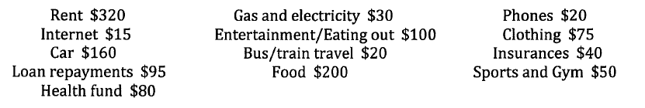
Household Expenditure
Fixed expenditure
Discretionary expenditure

Slide 4
Fixed expenses
Fixed expenses generally remain the same every month (e.g. rent, internet charges, health fund, insurance). These expenses are usually paid on a regular basis, such as weekly, monthly or quarterly.
Discretionary spending
A discretionary expense can be recurring or non-recurring costs for non-essential items or services. It is generally not a fixed amount (e.g. the cost of eating out, buying new clothes etc.)

Slide 5
> 0 SURPLUS
Income - Expenditure
< 0 DEFECIT

Slide 6
Budgeting
An estimate of income and expenditure over a certain period of time.
What for?
To determine if we are in surplus deficit
To determine if we can cut down on some expenditure
To work out saving goals

Slide 7
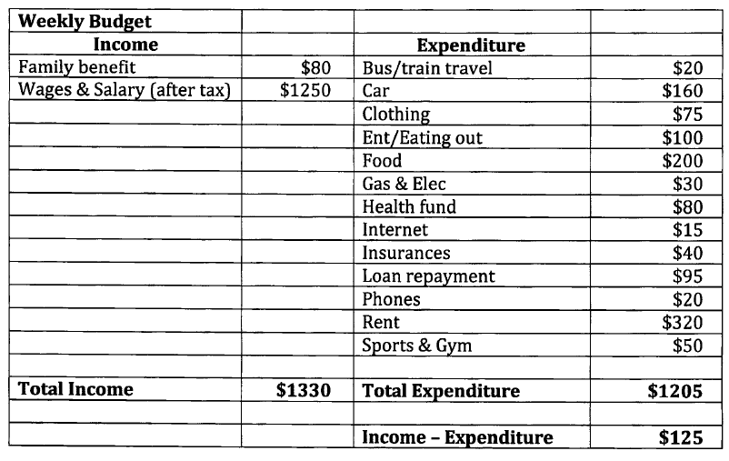

Slide 8
Be careful
Information will be given in
MONTHLY
WEEKLY
FORTNIGHTLY
Need to know how to convert from one to the other.

Slide 9
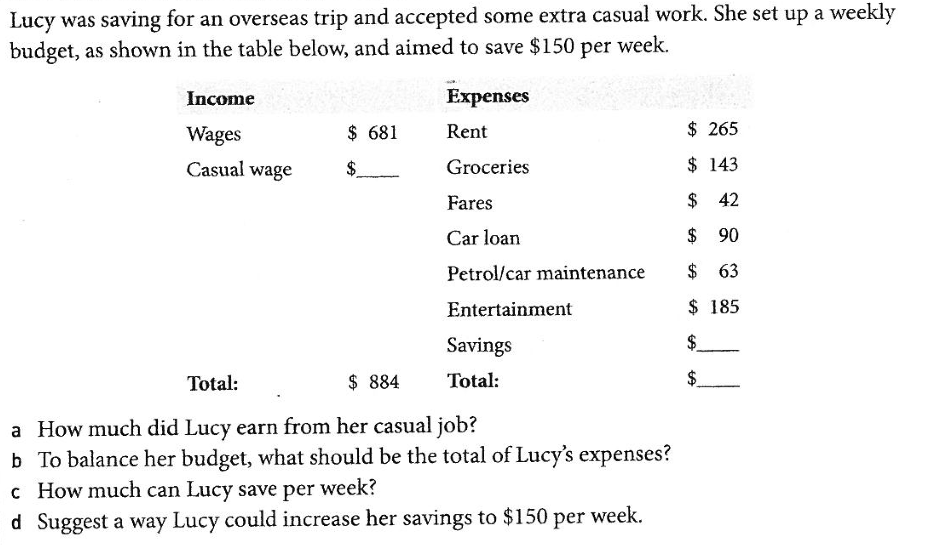

Slide 10
